Slide 1
Opening an Italian restaurant in Bristol
Dave Richards – Capstone Project

Slide 2
Introduction
As a resident of Bristol, Phil has not yet found an Italian restaurant he likes so decides to set one up with a business partner. In order to open up in the right area, Phil wants an overview of the competition and other types of restaurants in each postcode area of Bristol.
Data science can help Phil by quickly and easily getting details on venues for each area of Bristol, and cluster them together in order to quickly include/exclude areas from consideration. The results of the code will change as venues from the Foursquare API change - so Phil can re-run the code whenever he finds a potential venue for his restaurant to get an up to date result to base his decision upon.

Slide 3
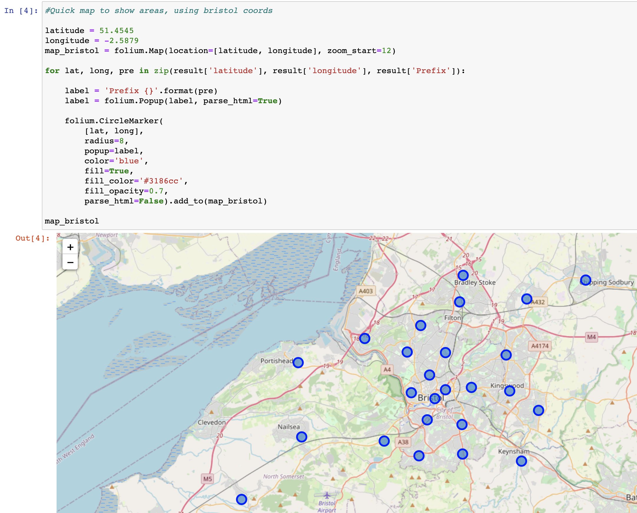
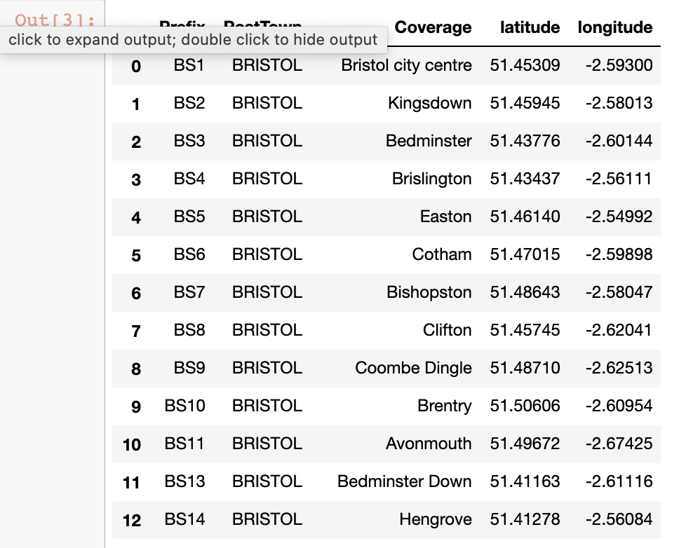
Building the initial dataframe
I scraped the BS Postcode Area Wikipedia page to get the relevant areas, and combined them with latitude and longitude data from a free online resource, to produce my initial dataframe, and accompanying map to visualize the postcode areas of Bristol, dropping non-geographic ones.
Initial map
Initial dataframe

Slide 4
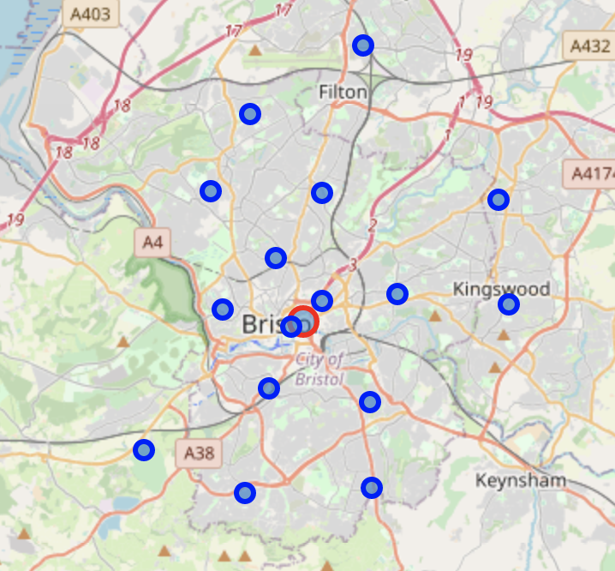
Picking potential areas based on location
As many areas shown are outside the city centre, I took the distance from the centre for each one, added this to the dataframe and filtered the frame to only include relatively central locations to ensure any new restaurant would be guaranteed good footfall.
Through trial and error, I selected the areas shown on the map, the red circle indicates the centre of the city

Slide 5
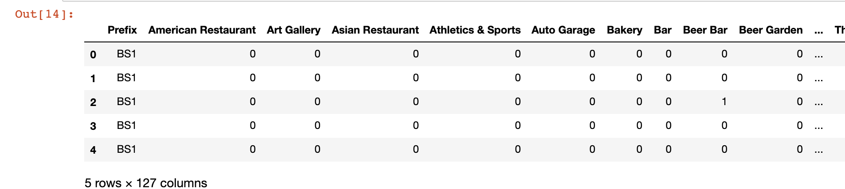
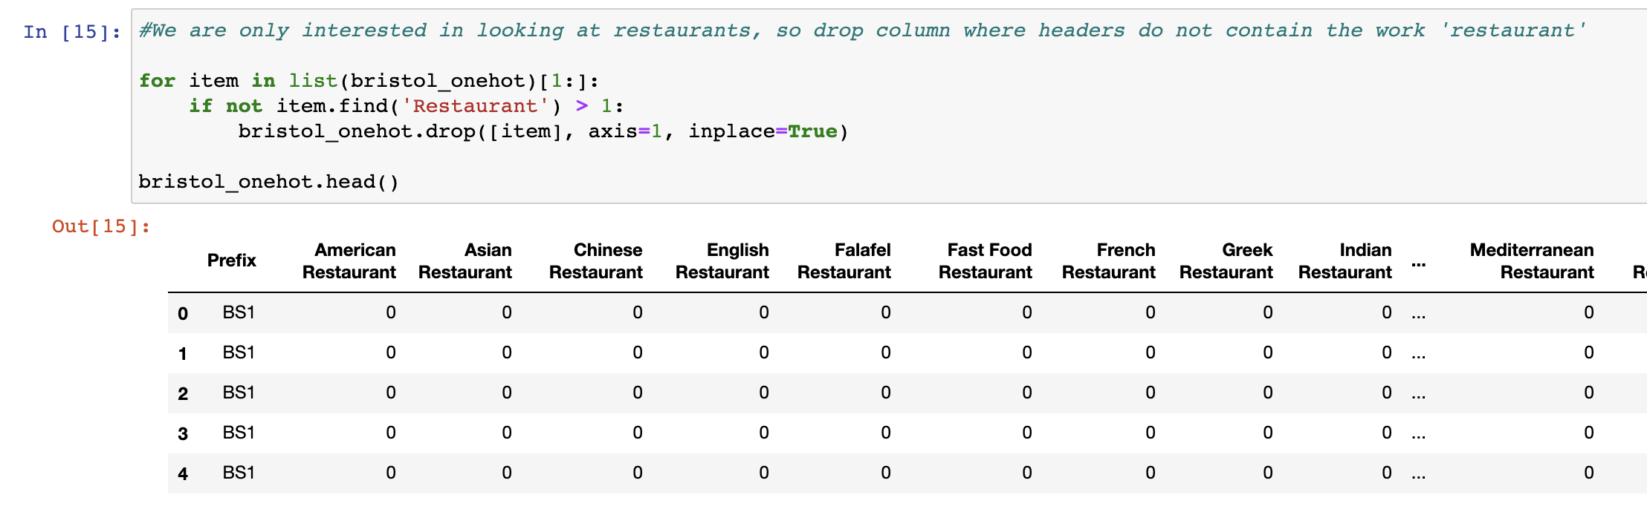
Adding the venues
After encoding
After building the initial dataframe, I used the Foursquare API to get venue details for each area, added the information to the dataframe and used one-hot encoding process to produce a numerical representation of the different categories each venue fell under, for use when clustering later in the project.
Dropping restaurant columns (dropping rows after this screenshot)
As we are opening a restaurant, I decided to only look at ‘restaurant’ categories, by removing the columns for categories that were not restaurants and then dropping rows where all the values = 0, I could create a new frame only containing restaurant venues.

Slide 6
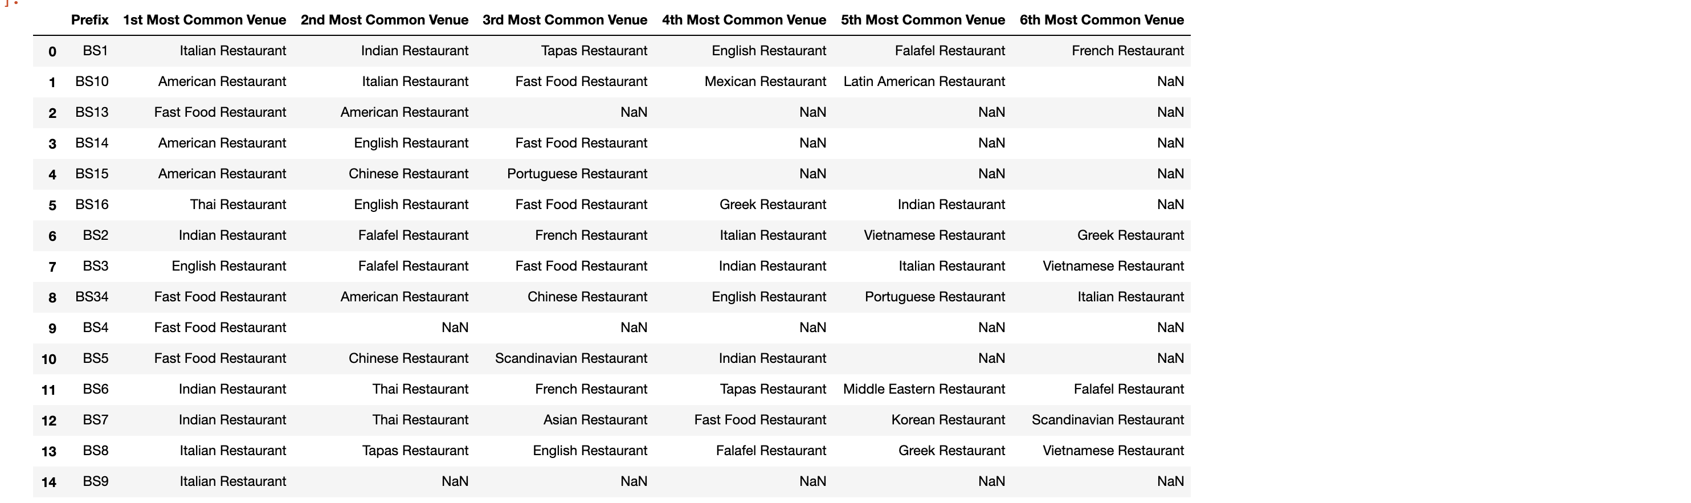
Most Popular Venues
After encoding, I found the most popular restaurant venue categories, for each postcode area, and turned this into a new dataframe in order to run my clustering algorithm mentioned in the next slide.
I ensured areas with few venues, did not have incorrect (0 value) data pulled into the frame.

Slide 7
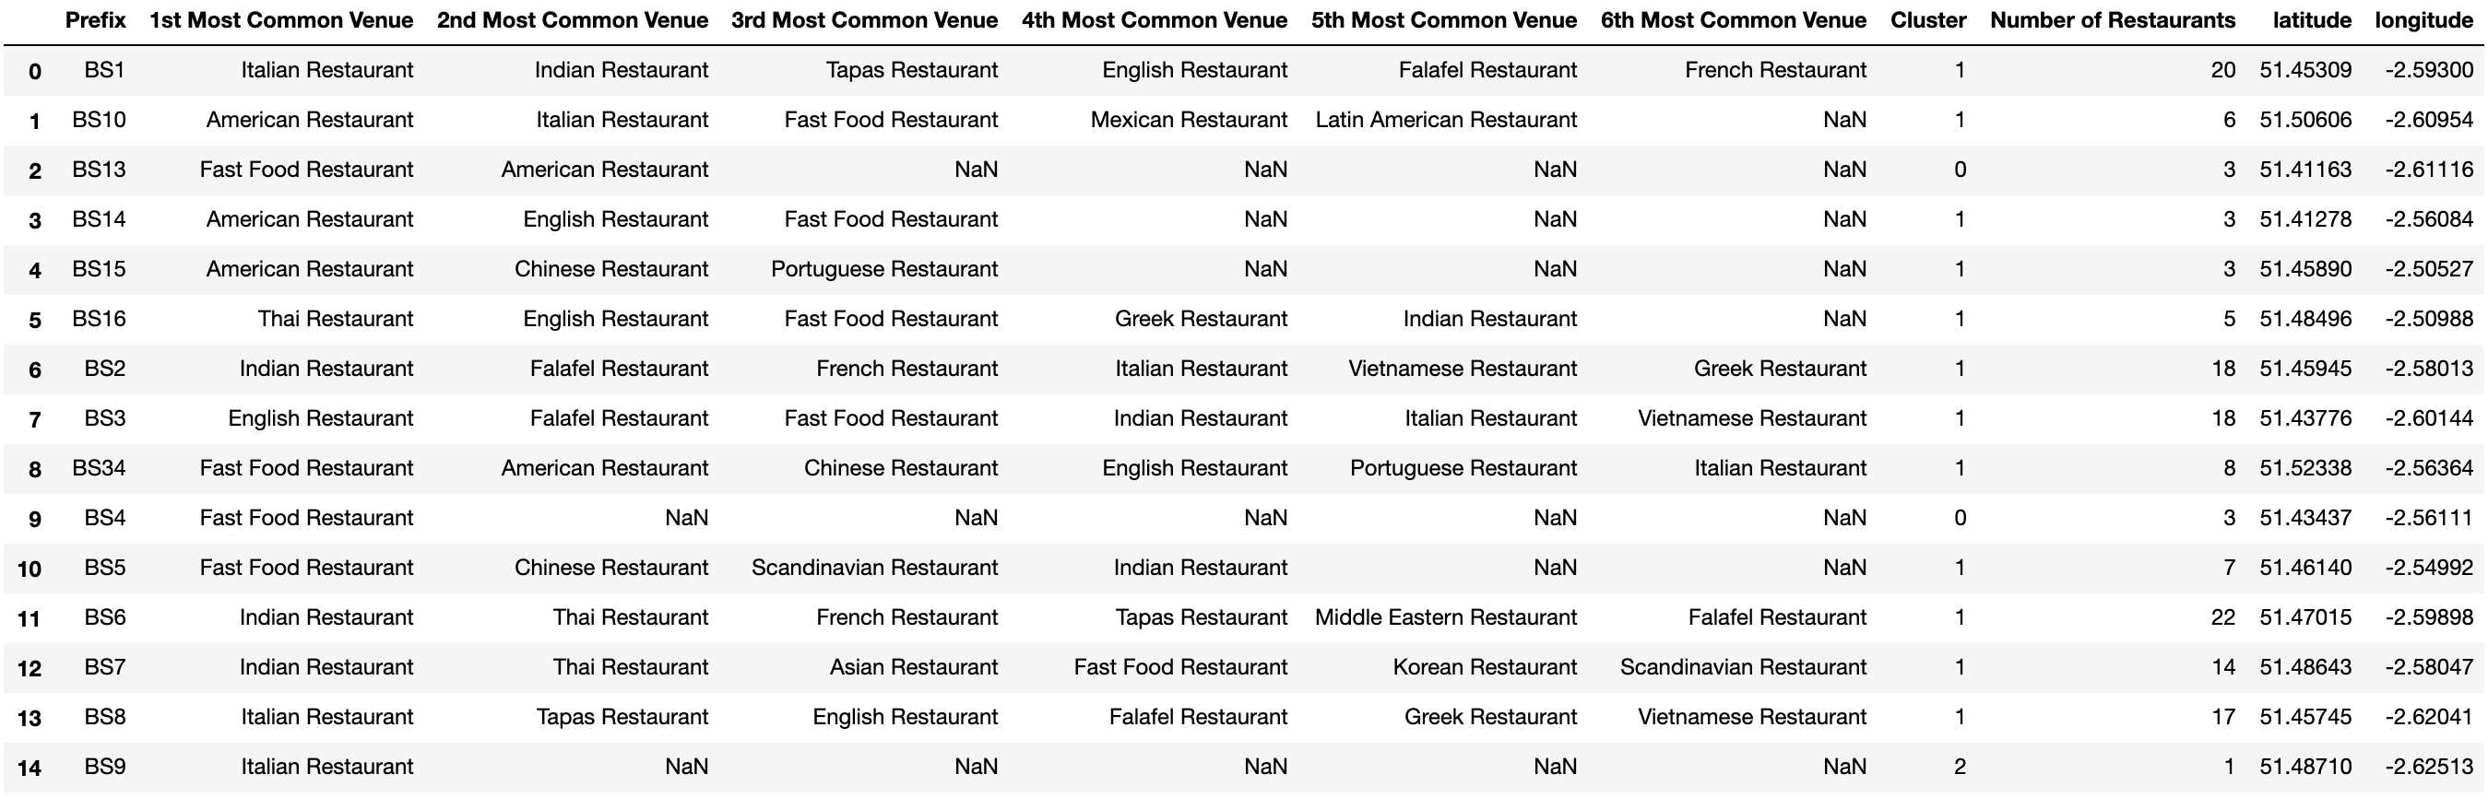
Clustering
After encoding, I did a k-nearest neighbor clustering algorithm on the data, with 3 clusters to give an idea as to the similar areas in the city in terms of popular restaurant cuisines. I then added the cluster labels to the dataframe, as well as the number of restaurants in the area – this information combined gave me a good understanding as to areas with less Italian cuisine options than others, and areas with less competition overall from other restaurants. Final dataframe below.

Slide 8
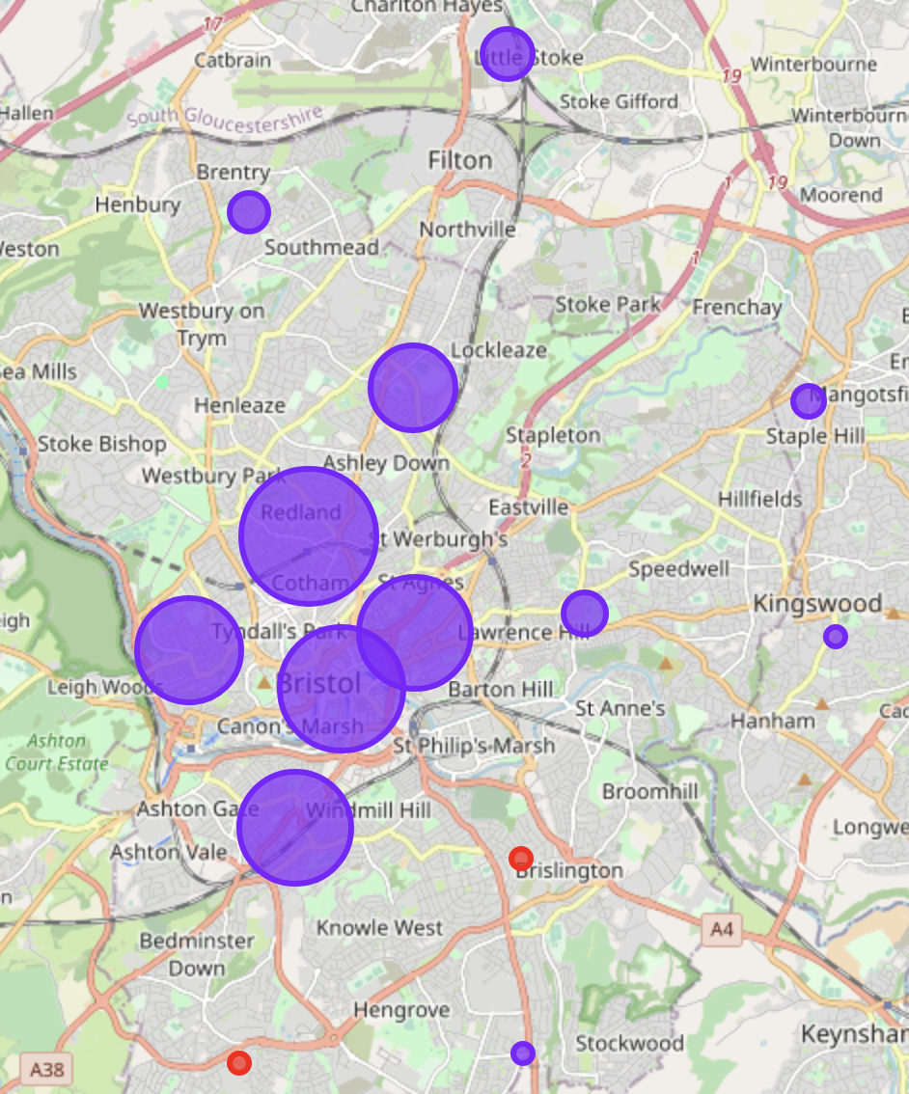
Conclusion & Map
From looking at the makeup of the clusters, and the map - I think BS4 or BS13 would be the best places to potentially open an Italian restaurants, neither of them are flooded with too many restaurants, and both are in a cluster with no other Italian restaurants
The map shows all the areas, colours displaying their clusters and size displaying number of restaurants currently in the area

